Slide 1
International Workshop on Modeling Biological Macromolecules
This module will consist of a
mini-lecture on molecular simulation including Markov Chain Monte Carlo, Molecular Dynamics and Hybrid Monte Carlo
walk-through of a python script to run HMC with Robosample
At the end of this module, you should be able to address these questions:
What is Markov Chain Monte Carlo and Molecular Dynamics?
What is Hybrid Monte Carlo and why do people use it?
Generally speaking, how does a Hybrid Monte Carlo simulation work?
You should also be able to run a simulation of a simple system using Robosample

Slide 2
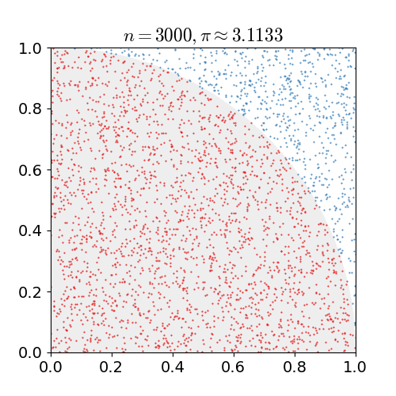
Monte Carlo
Monte Carlo simulation:
named after famous gambling city
uses random numbers
usually applied to hard deterministic or probabilistic problems
Examples:
pi approximation
virtually tossing a coin or rolling a dice many times
estimating financial risk (uncertainty in unit price, sales…)
solving integrals / differential equations
Hard to use for complex highly dimensional problems
Notes:
https://en.wikipedia.org/wiki/Monte_Carlo_method: Kalos, Malvin H.; Whitlock, Paula A. (2008). Monte Carlo Methods. Wiley-VCH. ISBN 978-3-527-40760-6.

Slide 3


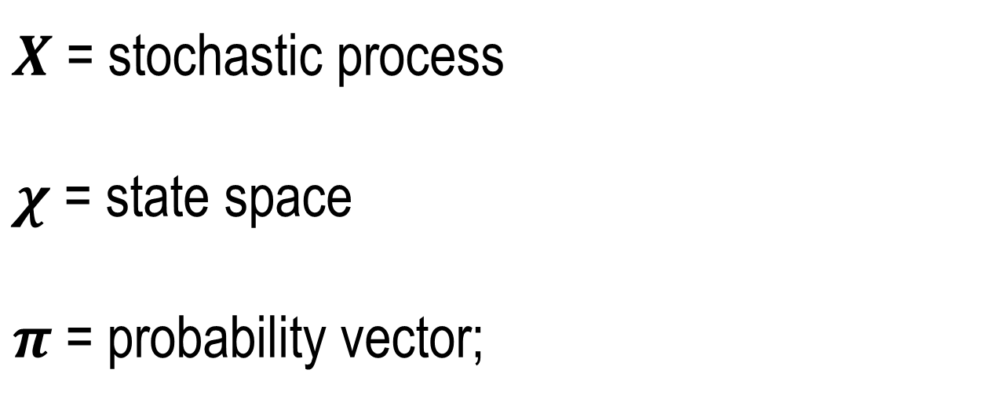
Markov Chains
Stochastic process: Sequence of indexed random variables
Markovian property: memoryless:
future only depends on the present
$X$ = stochastic process
$χ$ = state space
$π$ = probability vector;
$$π=\left[π\left(A\right),π\left(B\right)\right], π(A)=P(X_{ }=A)$$
PAST
$$X=\left\{X_{0},X_{1},X_{2}….\right\}, X_{i}=x∈χ, π_{ }(χ)$$
PRESENT
FUTURE
$$P\left(X_{i+1} | X_{i}=x_{i},X_{i−1}=x_{i−1}…,X_{0}=x_{0}\right)=P\left(X_{i+1} | X_{i}=x_{i} \right)$$

Slide 4
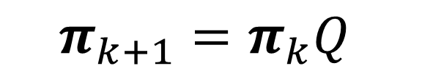
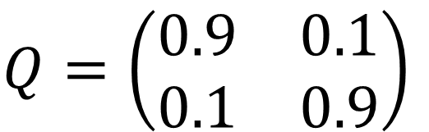
Markov Chains
Markov chains can be represented as graph diagrams where nodes are states and edges can be weighted by transition probabilities
Transition probabilities can be expressed as a transition matrix
PAST
0.9
H
T
PRESENT
0.1
0.1
FUTURE
0.9
transition matrix
$$Q=\left(\begin{matrix}0.9 & 0.1 \\ 0.1 & 0.9\end{matrix}\right)$$
probability vector evolution
$$π_{k+1}=π_{k}Q$$

Slide 5

Markov Chains Properties
Stationarity (equilibrium):
Irreducibility
for any two states A, B, if we start in A, we will eventually get to B
Aperiodicity
states are reached at integer multiples
Reversibility guarantees convergence to a stationarity distribution (detailed balance condition)
$$πQ=π$$
A
B
A
B
C
D
C
A
B
$$π\left(A\right)P\left(A→B\right)=π\left(B\right)P\left(B→A\right)$$

Slide 6
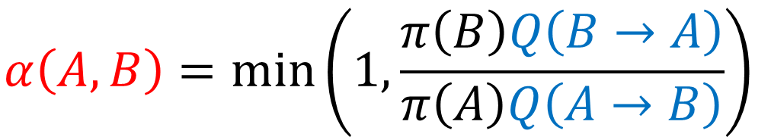
Metropolis – Hastings Algorithm Derivation
Markov Chain Monte Carlo usefulness: construct our own Markov Chain that converges to a specific probability distribution.
for molecules : the states are the configurations
detailed balance
$$π\left(A\right)P\left(A→B\right)=π\left(B\right)P\left(B→A\right)$$
proposal distribution
$$π\left(A\right)Q\left(A→B\right)≠π\left(B\right)Q\left(B→A\right)$$
correcting term
$$π\left(A\right)Q\left(A→B\right)α(A,B)=π\left(B\right)Q\left(B→A\right)α(B,A)⇔\frac{α(A,B)}{α(B,A)}=\frac{π\left(B\right)Q\left(B→A\right)}{π\left(A\right)Q\left(A→B\right)}$$
Metropolis-Hastings
$$α\left(A,B\right)=min\left(1,\frac{π\left(B\right)Q\left(B→A\right)}{π\left(A\right)Q\left(A→B\right)}\right)$$
Notes:
Alternative demonstration: https://www.youtube.com/watch?v=5lyw0nnyJt8 .

Slide 7
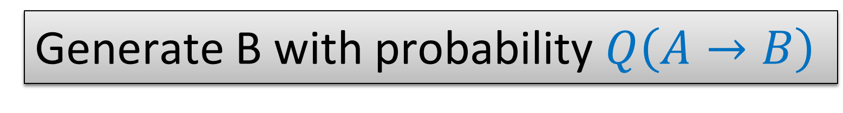
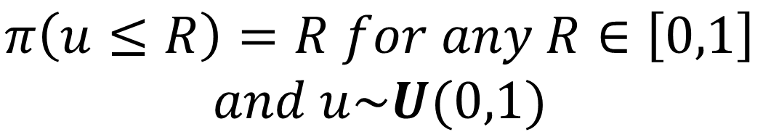
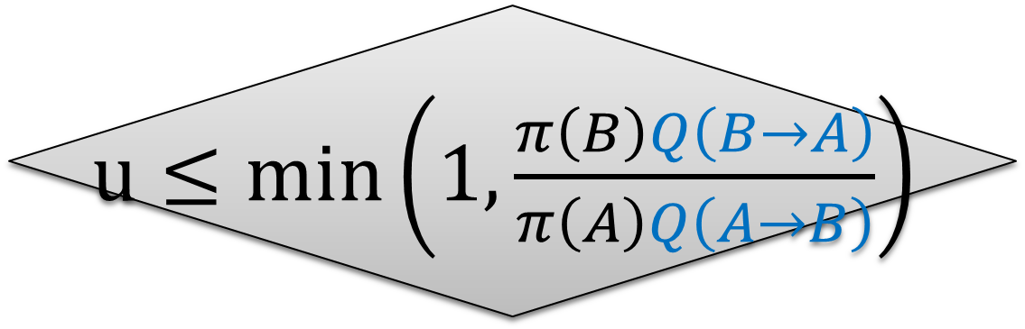
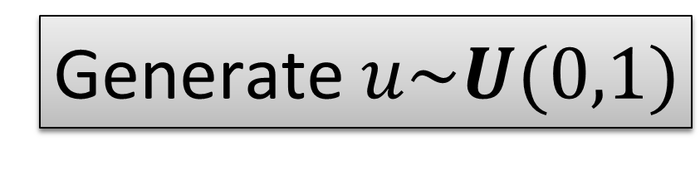
Metropolis – Hastings Algorithm
Draw A from initial π
$$π\left(u≤R\right)=R for any R∈\left[0,1\right]$$
$$and u\sim U(0,1)$$
0
R
1
Generate B with probability $Q\left(A→B\right)$
Generate $u\sim U(0,1)$
$u≤min\left(1,\frac{π\left(B\right)Q\left(B→A\right)}{π\left(A\right)Q\left(A→B\right)}\right)$
Reject (A → A)
NO
YES
Accept (B → A)

Slide 8
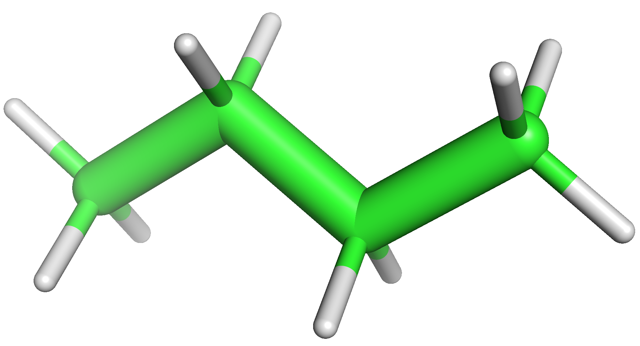
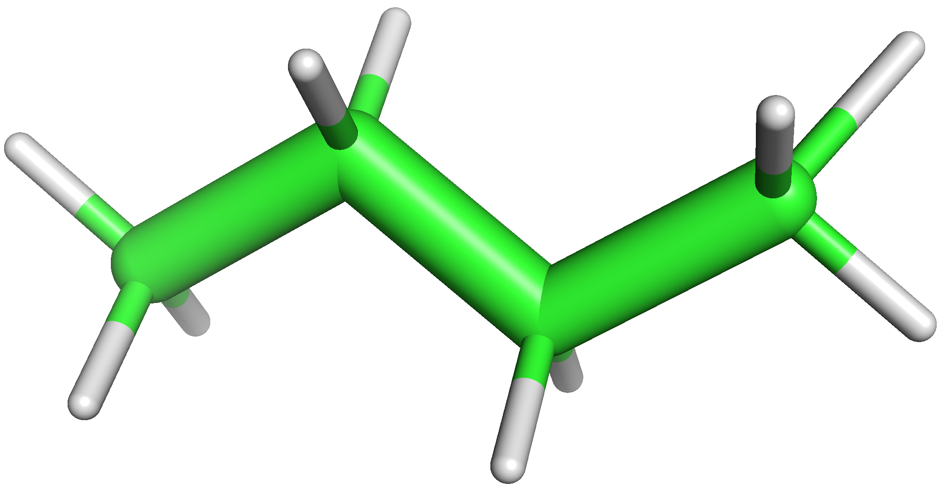
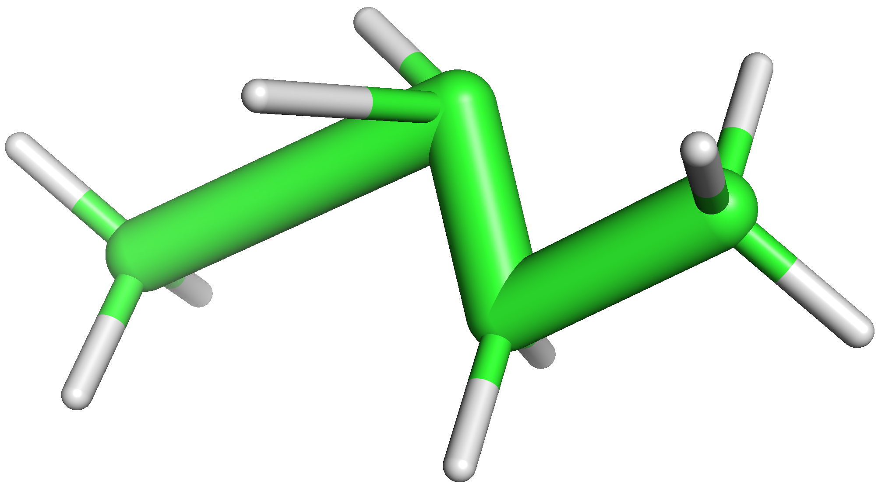
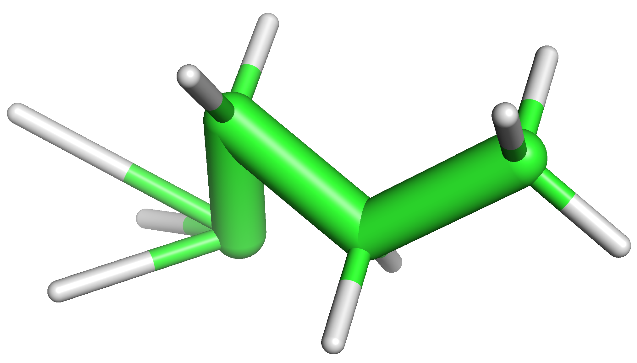
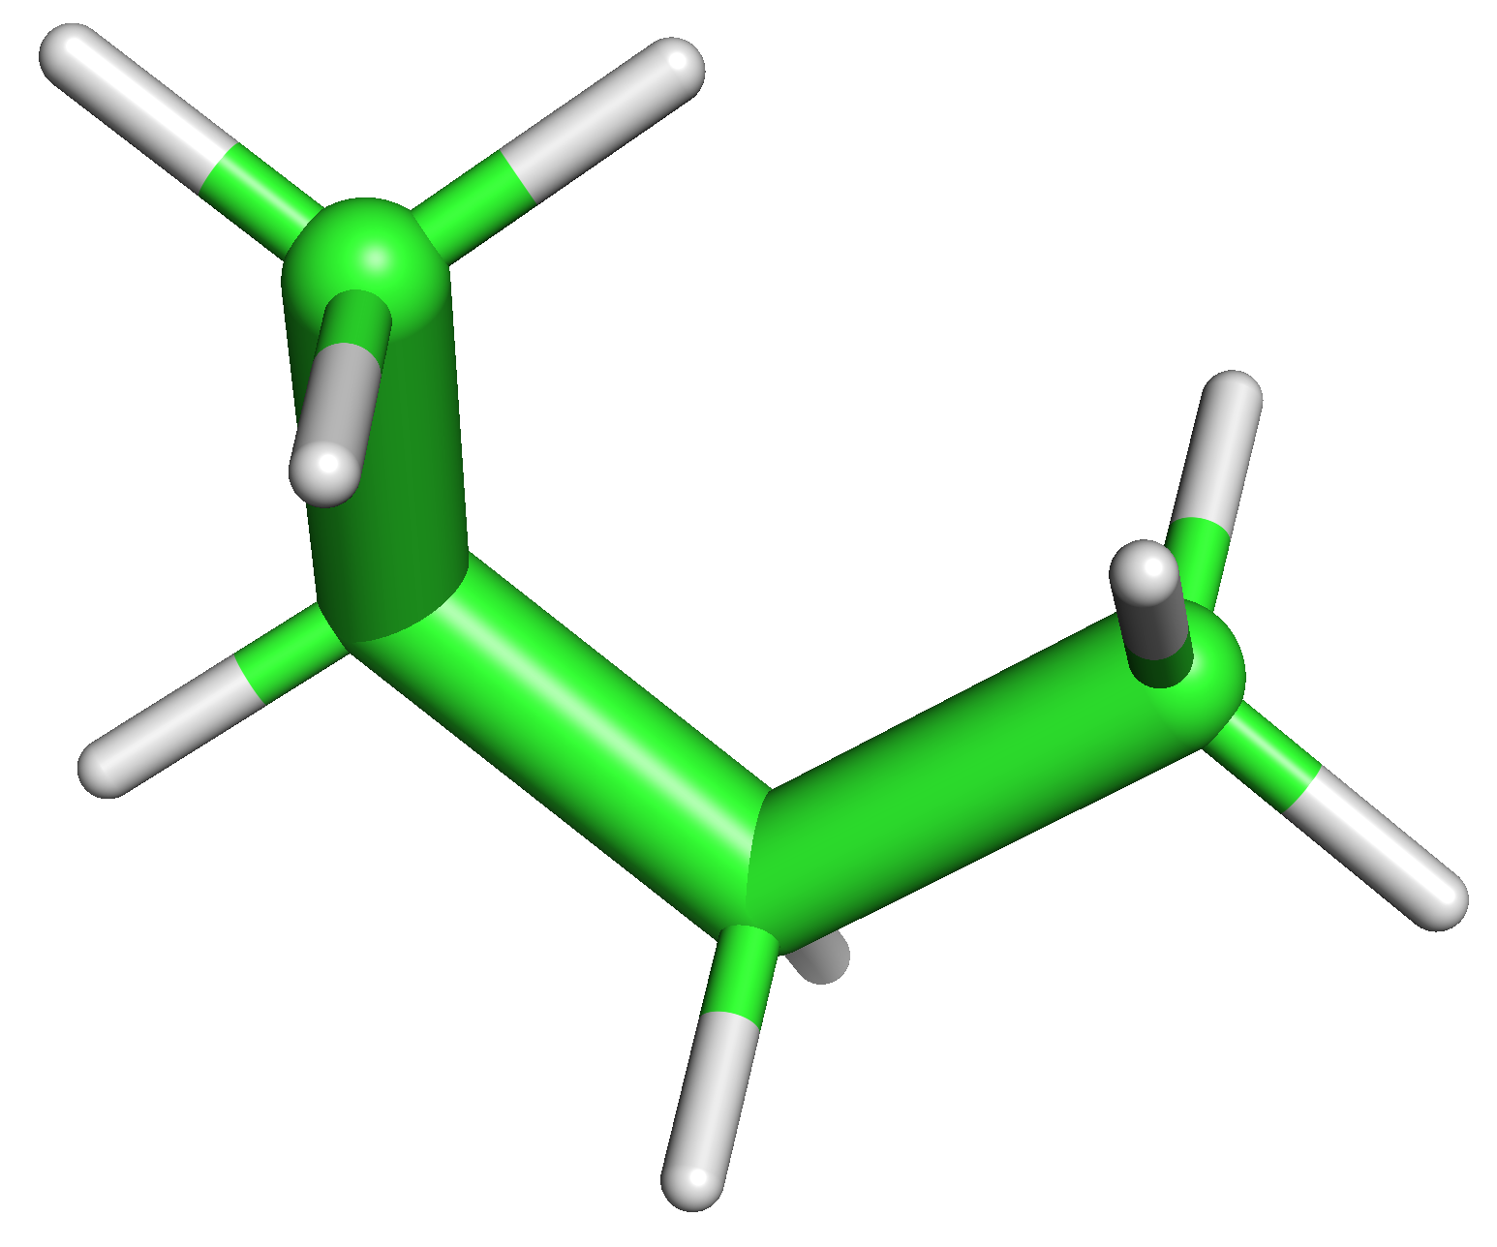
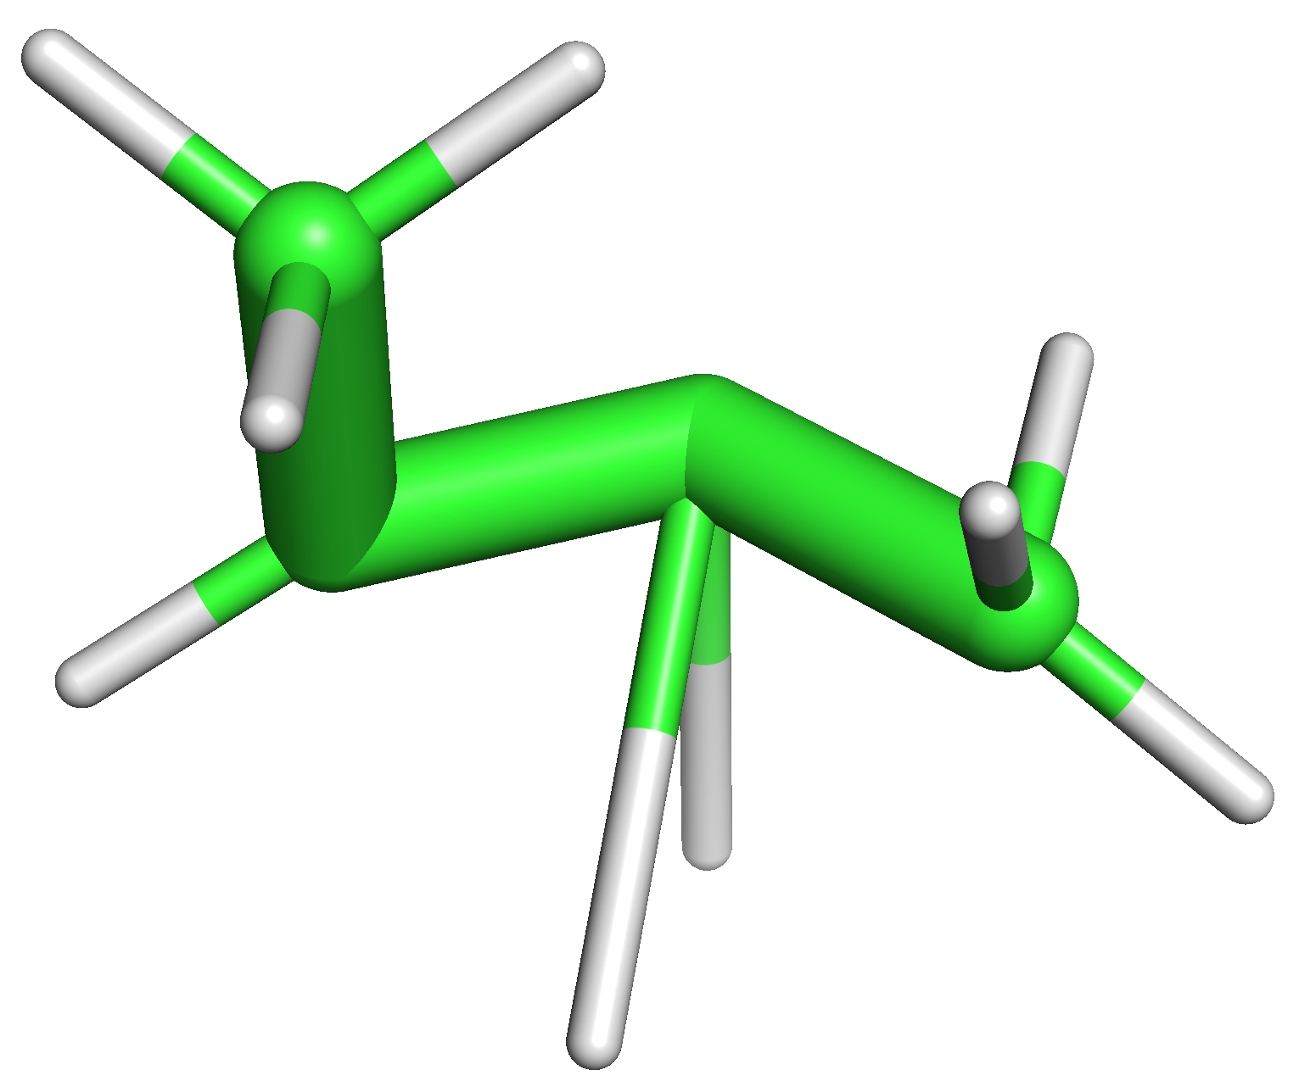
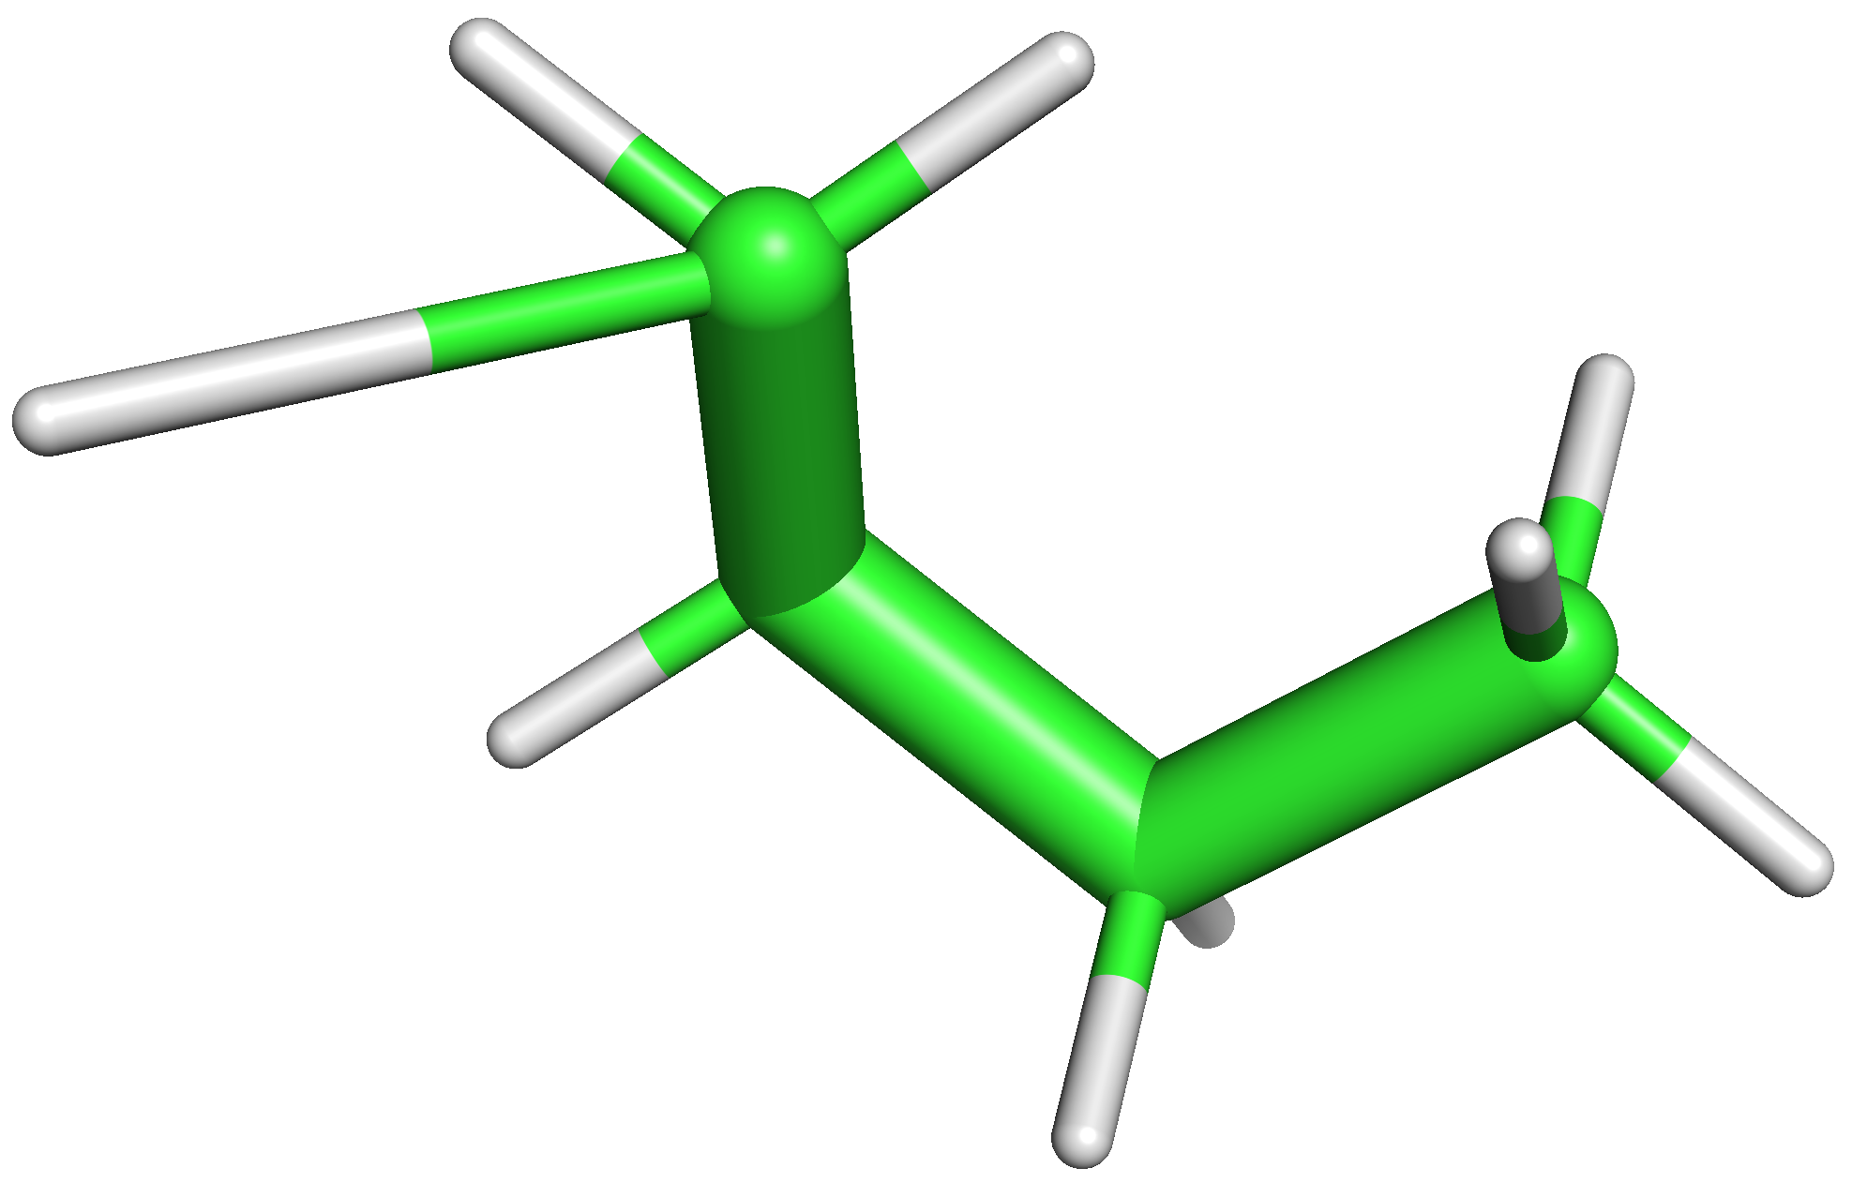
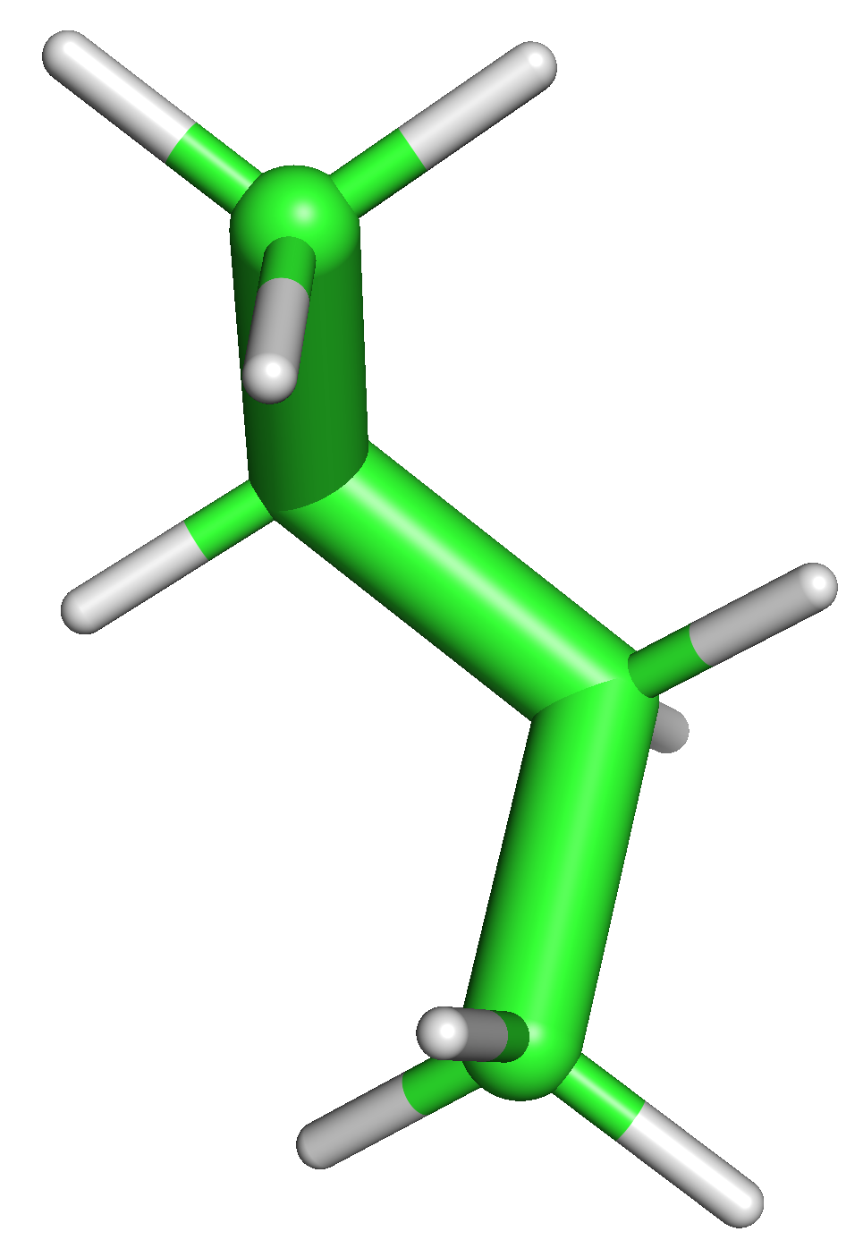
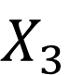
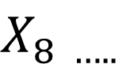
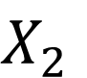
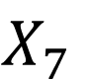
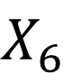
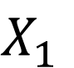
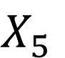
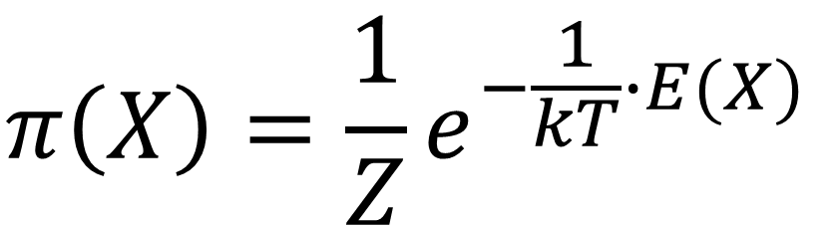
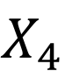
Markov Chain Monte Carlo for molecules
Randomly choose configurations
$$X_{1}$$
$$X_{2}$$
$$X_{3}$$
$$X_{4}$$
$$X_{5}$$
$$X_{6}$$
$$X_{7}$$
$$X_{8 …..}$$
$$π\left(X\right)=\frac{1}{Z}e^{−\frac{1}{kT}∙E(X)}$$
8

Slide 9
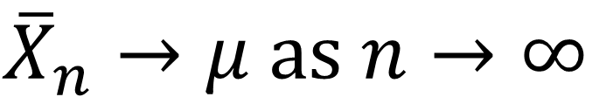
MCMC In Practice: When do we start recording?
The initial distribution is not known. Burn-in
achieve “stationarity” within a certain threshold
get to a high probability region
$${\overline{X}}_{n}→μ as n→∞$$

Slide 10
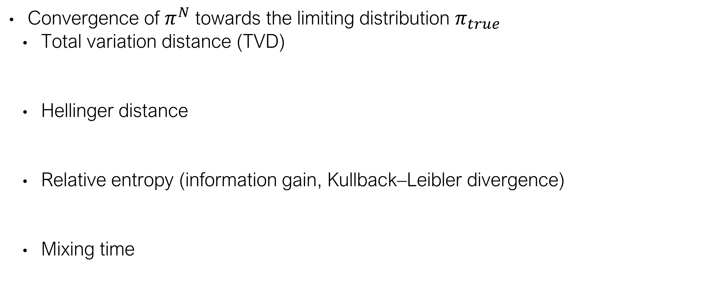
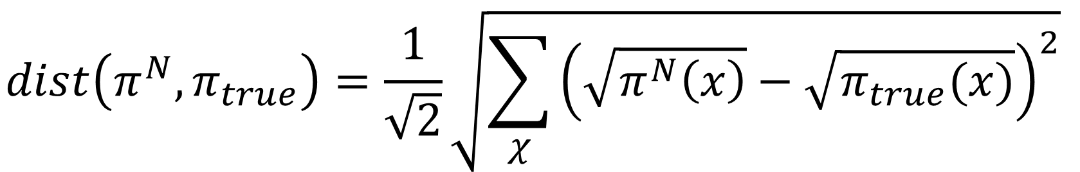
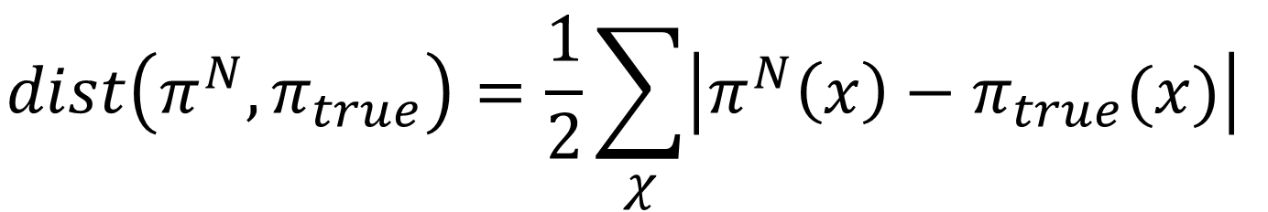
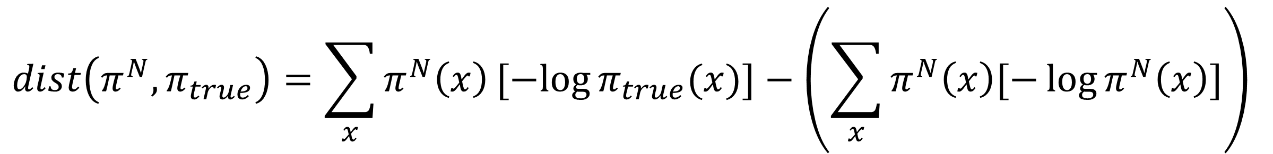
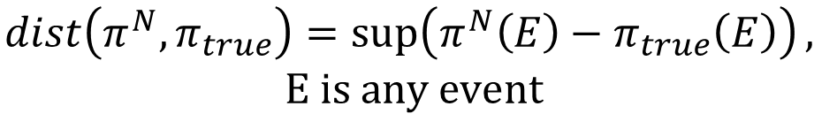
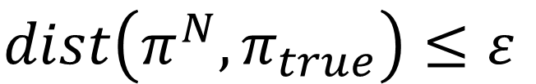
MCMC In Practice: When do we stop recording?
Convergence of $π^{N}$towards the limiting distribution $π_{true}$
Total variation distance (TVD)
Hellinger distance
Relative entropy (information gain, Kullback–Leibler divergence)
Mixing time
$$dist\left(π^{N},π_{true}\right)≤ε$$
$$dist\left(π^{N},π_{true}\right)=\frac{1}{2}\sum_{χ}{\left|π^{N}\left(x\right)−π_{true}(x)\right|}$$
$$dist\left(π^{N},π_{true}\right)=\sup\left(π^{N}\left(E\right)−π_{true}\left(E\right)\right),$$
$$E is any event$$
$$dist\left(π^{N},π_{true}\right)=\frac{1}{\sqrt{2}}\sqrt{\sum_{χ}{{\left(\sqrt{π^{N}\left(x\right)}−\sqrt{π_{true}(x)}\right)}^{2}}}$$
$$dist\left(π^{N},π_{true}\right)=\sum_{x}{π^{N}\left(x\right)[−log{π_{true}(x)}]}−\left(\sum_{x}{π^{N}\left(x\right)[−\log{π^{N}\left(x\right)}]}\right)$$
$$t_{mix}\left(ε\right)=min⁡\{t:dist(t)≤ε\}$$
Levin Peres and Wilmer, “Markov Chains and Mixing Times”
Notes:
KL distance is not a true metric. Triangle inequality doesn’t hold.

Slide 11
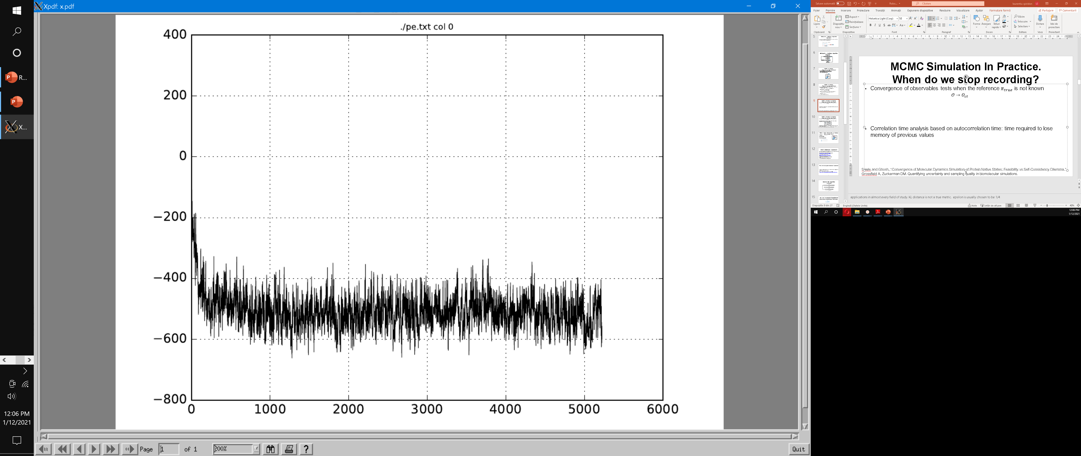
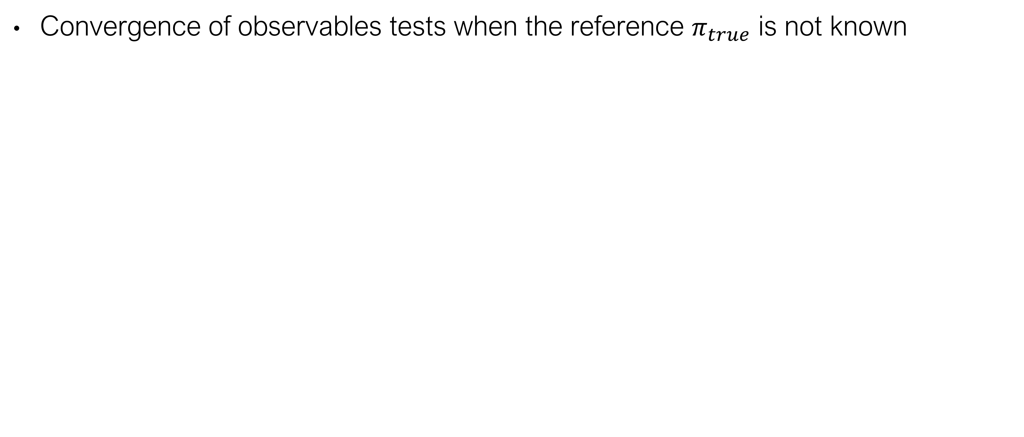
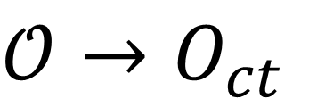
MCMC Simulation In Practice. When do we stop recording?
Convergence of observables tests when the reference $π_{true}$ is not known
$$𝒪→O_{ct}$$
PE
step
Sawle and Ghosh, “Convergence of Molecular Dynamics Simulation of Protein Native States: Feasibility vs Self-Consistency Dilemma.”
Grossfield A, Zuckerman DM. Quantifying uncertainty and sampling quality in biomolecular simulations.
Notes:
until it looks ok

Slide 12
MCMC Simulation In Practice. When do we stop recording?
Self-consistency tests: “monitoring the overlap between full and partial trajectories”. E.g. constant number of clusters.
2
1
2
1
3
3
5
4
4
Sawle and Ghosh, “Convergence of Molecular Dynamics Simulation of Protein Native States: Feasibility vs Self-Consistency Dilemma.”
Grossfield A, Zuckerman DM. Quantifying uncertainty and sampling quality in biomolecular simulations.

Slide 13
MCMC In Practice: How efficient is it?
Correlation time analysis: time required to lose memory of previous values
Hitting time
Cover time
Mean first passage matrix
1
2
5
3
4
 | 1 | 2 | 3 | 4 | 5
1
2
3
4
5

Slide 14
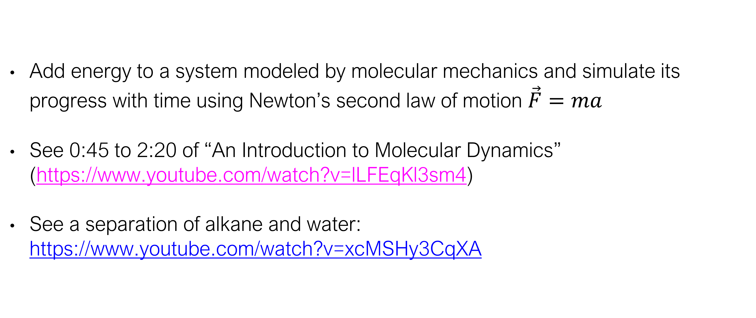
What is Molecular Dynamics?
Add energy to a system modeled by molecular mechanics and simulate its progress with time using Newton’s second law of motion $\vec{F}=ma$
See 0:45 to 2:20 of “An Introduction to Molecular Dynamics” (https://www.youtube.com/watch?v=lLFEqKl3sm4)
See a separation of alkane and water: https://www.youtube.com/watch?v=xcMSHy3CqXA

Slide 15
Why do biological molecular dynamics?
“everything that living things do can be understood in terms of the jigglings and wigglings of atoms” - Richard Feynman
Check out David’s molecular dynamics YouTube playlist: https://www.youtube.com/playlist?list=PLYEyeVFrqfAu0ft6sF4vVe5FOEbJYyi_L

Slide 16
General MD Algorithm
Figure 2 of Durrant & McCammon, 2011

Slide 17
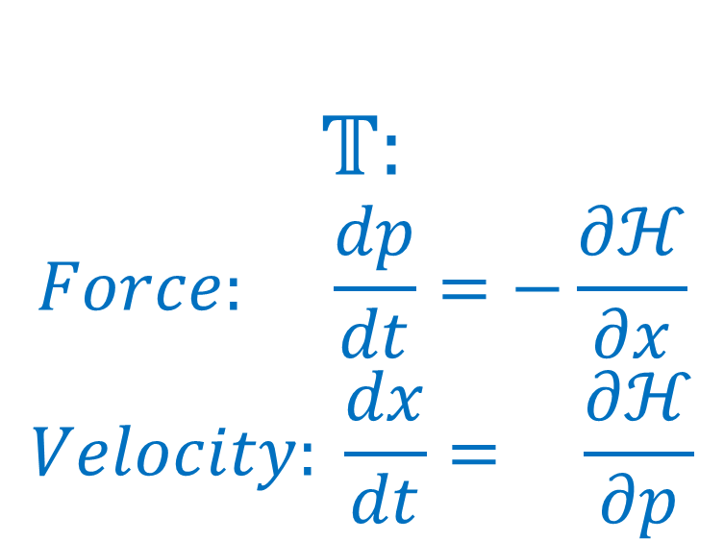
How do we calculate trajectories?
Evolution in time given is by classical mechanics:
Integrate trajectory using Taylor expansion
$$𝕋:$$
$$Force: \frac{dp}{dt}=−\frac{∂ℋ}{∂x}$$
$$Velocity: \frac{dx}{dt}= \frac{∂ℋ}{∂p}$$
$$x\left(t\right)=\frac{1}{0!}x\left(t_{0}\right){\left(t−t_{0}\right)}^{0}+\frac{1}{1!}\frac{dx}{dt}\left(t_{0}\right){\left(t−t_{0}\right)}^{1}+\frac{1}{2!}\frac{d^{2}x}{{dt}^{2}}\left(t_{0}\right){\left(t−t_{0}\right)}^{2}+\frac{1}{3!}\frac{d^{3}x}{{dt}^{3}}\left(t_{0}\right){\left(t−t_{0}\right)}^{3}+…$$

Slide 18

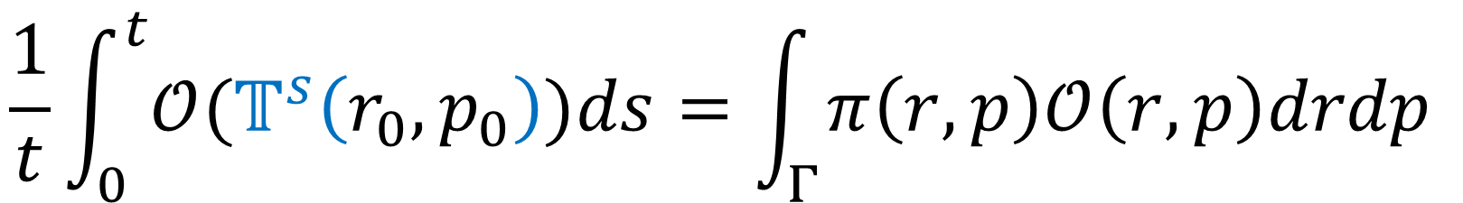
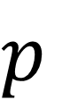
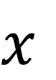
Ergodic Hypothesis
Evolution in time given by classical mechanics:
Time averages equals space averages
$$𝕋:$$
$$Force: \frac{dp}{dt}=−\frac{∂ℋ}{∂r}$$
$$Velocity: \frac{dr}{dt}= \frac{∂ℋ}{∂p}$$
$$p$$
$$\frac{1}{t}\int_{0}^{t}{{𝒪(𝕋}^{s}\left(r_{0},p_{0}\right))ds}=\int_{Γ}^{ }{π\left(r,p\right)𝒪\left(r,p\right)drdp}$$
$$x$$

Slide 19
Disscussion
 | MCMC | MD
Uses random numbers as its main tool
Needs accelerations during calculation
May use the Metropolis-Hastings algorithm
Allows the calculation of averages
In principle, has memory of its past

Slide 20
Markov Chain Monte Carlo for biological molecules
Randomly chosen configurations lead to low acceptance rates
Can we do better?
$$X_{1}$$
$$X_{2}$$
$$X_{3}$$
$$X_{4}$$
$$X_{5}$$
$$X_{6}$$
$$X_{7}$$
$$X_{8 …..}$$
20

Slide 21
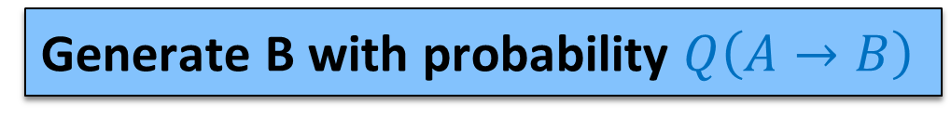
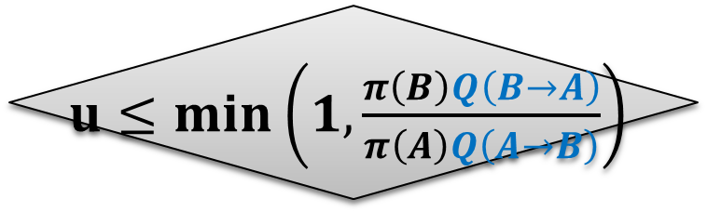
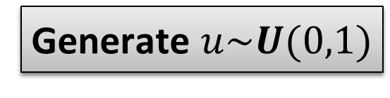
Hybrid Monte Carlo
Draw A from initial π
Generate B with probability $Q\left(A→B\right)$
Molecular Dynamics
Metropolis-Hastings
Algorithm
Generate $u\sim U(0,1)$
NO
$u≤min\left(1,\frac{π\left(B\right)Q\left(B→A\right)}{π\left(A\right)Q\left(A→B\right)}\right)$
YES
Reject (A → A)
Accept (B → A)
21

Slide 22
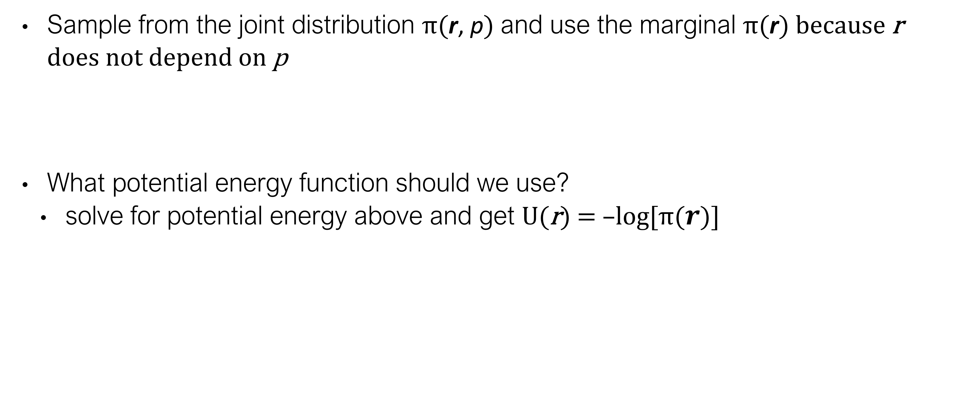
Why does it work?
Sample from the joint distribution π(r, p) and use the marginal π(r) because r does not depend on p
What potential energy function should we use?
solve for potential energy above and get U(r) = –log[π($r$)]
$$π\left(r,p\right)∝e^{−βU\left(r\right)}e^{−β{\frac{1}{2}p}^{T}M^{−1}p}=e^{−βU\left(r\right)}𝒩(0,M)$$

Slide 23
Why use constraints?
Target distribution is highly dimensional and too complex to get conclusive results in reasonable amount of time
Heavier bodies allows the increase of the timestep
E.g. :
rigid water molecules (TIP3P model)
hydrogen bond lengths
constant bond lengths and bond angles: torsional dynamics
constrain specific regions of molecules or even entire domains

Slide 24
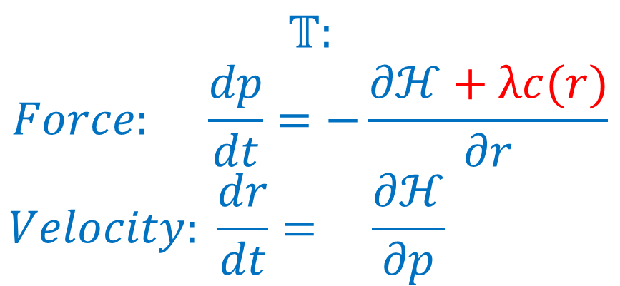
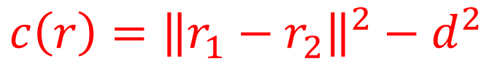
How to impose constraints?
Cartesian coordinates
Dynamics with maximal coordinates (Lagrange multipliers)
Example SHAKE algorithm
r₁
r₂
$$𝕋:$$
$$Force: \frac{dp}{dt}=−\frac{∂ℋ+λc(r)}{∂r}$$
$$Velocity: \frac{dr}{dt}= \frac{∂ℋ}{∂p}$$
$$c\left(r\right)={\left\|r_{1}−r_{2}\right\|}^{2}−d^{2}$$
$$r\left(t\right)=\frac{1}{0!}r\left(t_{0}\right){\left(t−t_{0}\right)}^{0}+\frac{1}{1!}\frac{dr}{dt}\left(t_{0}\right){\left(t−t_{0}\right)}^{1}+\frac{1}{2!}\frac{d^{2}r}{{dt}^{2}}\left(t_{0}\right){\left(t−t_{0}\right)}^{2}+…$$
Taken from Figure 3 of Durrant & McCammon, 2011.
Notes:
The quantization of molecular energy levels encompasses several mechanisms. in practice the different mechanisms differences in magnitude allow their characterization to be examined independently

Slide 25
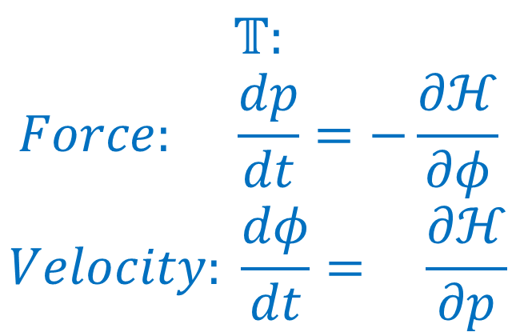
How to impose constraints?
d
Internal coordinates
BAT
Dynamics with reduced coordinates (Featherstone)
Rigid body dynamics includes rotational quantities which are incorporated using Euler’s laws of motion
$$𝕋:$$
$$Force: \frac{dp}{dt}=−\frac{∂ℋ}{∂φ}$$
$$Velocity: \frac{dφ}{dt}= \frac{∂ℋ}{∂p}$$
$$φ\left(t\right)=\frac{1}{0!}φ\left(t_{0}\right){\left(t−t_{0}\right)}^{0}+\frac{1}{1!}\frac{dφ}{dt}\left(t_{0}\right){\left(t−t_{0}\right)}^{1}+\frac{1}{2!}\frac{d^{2}φ}{{dt}^{2}}\left(t_{0}\right){\left(t−t_{0}\right)}^{2}+…$$
Taken from Figure 3 of Durrant & McCammon, 2011.
Notes:
Internal coordinates forms a curvilinear system that has to be corrected for. Hamiltonain has to be modified to match the target pi.

Slide 26
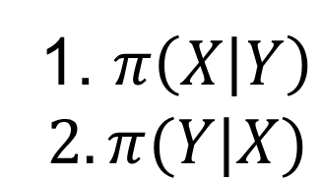
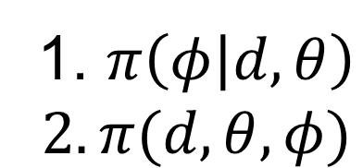
Gibbs sampling
Why?
Only simulating with constraints is not enough. The simulation does not cover the entire conformational space
Sampling from complex multivariate joint probability.
How?
Take turns in sampling from conditionals. Allow oversampling easier to sample variables.
Robosample scheme: constrained dynamics combined with all-atom dynamics
1. $π\left(X | Y\right)$
$$2. π(Y|X)$$
1. $π\left(φ | d,θ\right)$
$$2. π(d,θ,φ)$$
Notes:
Robosample uses Blocked Gibbs with Marginalization.

Slide 27
Why Robosample?
Many choices of software for molecular dynamics
https://en.wikipedia.org/wiki/Comparison_of_software_for_molecular_mechanics_modeling
https://www.rcsb.org/pages/thirdparty/modeling_and_simulation
Robosample is
rigid body dynamics
free
GPU-accelerated
can be used in python scripts/C++ programs

Slide 28
Review Questions
Generally speaking, how does a HMC simulation work?

Slide 29
References
Durrant, J. D.; McCammon, J. A. Molecular Dynamics Simulations and Drug Discovery. BMC Biol 2011, 9 (1), 71. https://doi.org/10.1186/1741-7007-9-71, adapted under the CC BY 2.0 license.
Kalos, Malvin H.; Whitlock, Paula A. (2008). Monte Carlo Methods.
Levin DA, Peres Y and Wilmer EL, “Markov Chains and Mixing Times”, American Mathematical Soc., Oct 31, 2017, ISBN: 1470429624, 9781470429621
Sawle L, Ghosh K. Convergence of Molecular Dynamics Simulation of Protein Native States: Feasibility vs Self-Consistency Dilemma. J Chem Theory Comput. 2016 Feb 9;12(2):861-9. doi: 10.1021/acs.jctc.5b00999. Epub 2016 Jan 26. PMID: 26765584.
Grossfield A, Zuckerman DM. Quantifying uncertainty and sampling quality in biomolecular simulations. Annu Rep Comput Chem. 2009 Jan 1;5:23-48. doi: 10.1016/S1574-1400(09)00502-7. PMID: 20454547; PMCID: PMC2865156.
Simon Duane, A.D. Kennedy, Brian J. Pendleton, Duncan Roweth, Hybrid Monte Carlo, Physics Letters B, Volume 195, Issue 2, 1987, Pages 216-222, ISSN 0370-2693,

